Slide 1


RPA Essential Training Nanyang Polytechnic School of Information Technology

Slide 2

Excel Functions
Introduction to Excel Functions

Slide 3
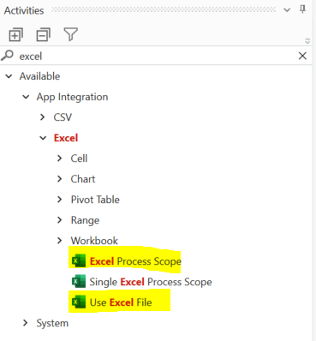
Excel
Excel activities can help to perform a lot of the same actions in a excel application.
Excel Process Scope
For ALL Excel functions, you must add into a Process Scope
Use Excel File
To Open an Excel File, you use this activity.
Notes:
In UiPath Studio, Data Table is a prototype of spreadsheet data that represents the row and column without any headers. The Excel application is a package that enables the excel activities with whole work. Apart from this, it specifies the .xlsx file where you want to work.
You can start with the data table, if you don't have MS office on your laptop, desktop. The Container properties of the data table make Excel application activity for each process such as Read Range, Append Range, Read cell, Write range, Sort Table. Along with these, other types of data table activities that can be done are: Get row item, Build data table, Data Table, For Each Row and Add data row.

Slide 4
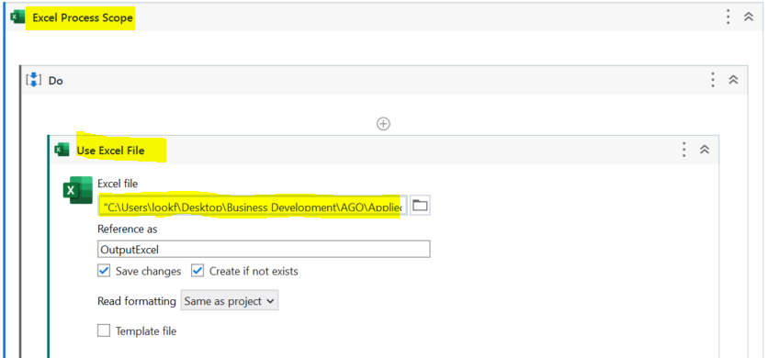
Add Excel Process Scope
Add Use Excel File INISIDE the Process Scope
All activities interacting with the excel file will be in the Use Excel File Body
The Use Excel File activity has to be within the Excel Process Scope.
This is the file path to the excel file.

Slide 5
Excel Functions
Introduction to Excel Functions
Reading excel files
Appending Range

Slide 6

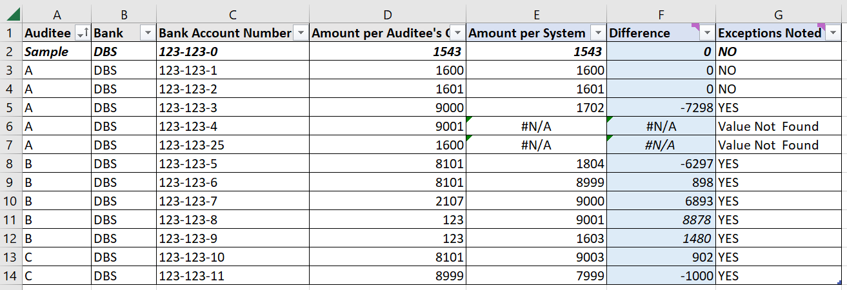
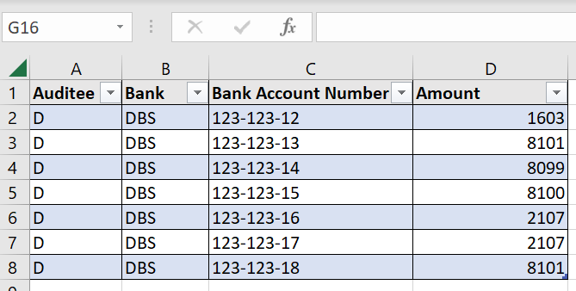
Sends Audit confirmation emails to Auditees for bank amount confirmation
Auditees replies with email with confirmation of bank account amounts
Check for emails from Auditees and download attachments
FOR EACH email and attachment, add the bank amount and other details to the Audit excel file
Every Excel File received from Auditees has multiple rows of data.
Auditees submits their confirmed bank amount via email.
Staff adds the rows from all the files into Output file.
VLookup formulas will match the bank account number and check if any exception is noted
We will need to read each file, then append them to the Output file.
X 3 Files

Slide 7
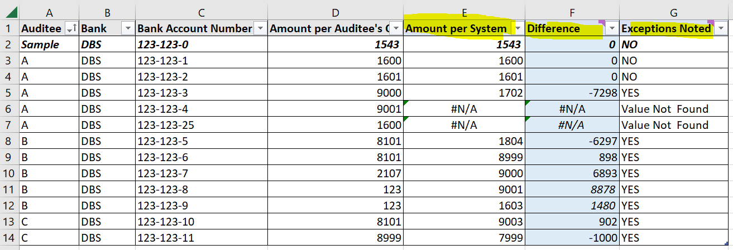
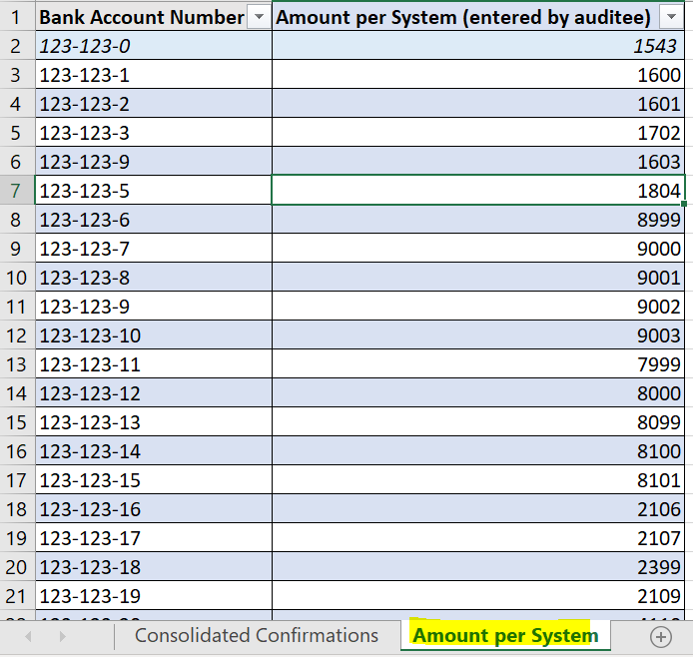
The output file has 3 derived columns
Amount per System has a VLookup that matches the Bank Account number with the 2nd excel sheet and retrieves the amount per system
Difference will minus the Amount given by Auditee against the Amount by system
Exceptions Noted will display
1) NO → No different in amount for column E and F
2) YES → Difference in amount for column E and F
3) Value not found → Bank account number does not match any account number in the look up table.

Slide 8

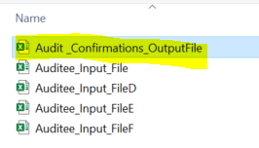
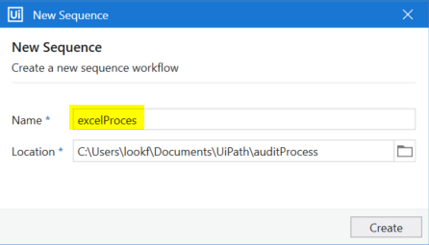
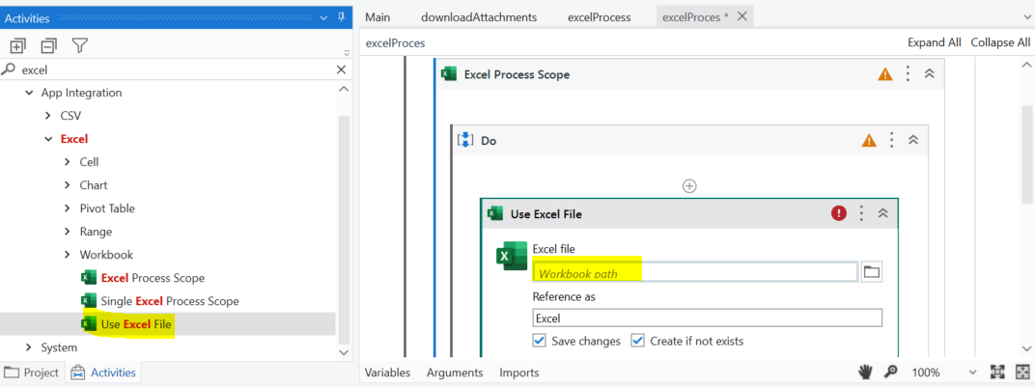
Sends Audit confirmation emails to Auditees for bank amount confirmation
Auditees replies with email with confirmation of bank account amounts
Check for emails from Auditees and download attachments
FOR EACH email and attachment, add the bank amount and other details to the Audit excel file
1) Add a new process XAML file and named it excelProcess
2) Add a Excel Process Scope activity into the sequence. Inside the process scope, add a Use Excel File Activity.
This is for OPENING the OUTPUT FILE FIRST.

Slide 9
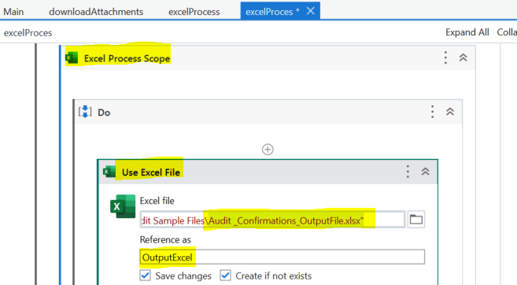
Sends Audit confirmation emails to Auditees for bank amount confirmation
Auditees replies with email with confirmation of bank account amounts
Check for emails from Auditees and download attachments
FOR EACH email and attachment, add the bank amount and other details to the Audit excel file
3) Make sure you browse to the Output file – Audit_Confirmations_OutputFile
Browse to the output file.
Rename this to OutputExcel for easier reference.
Next, we will need to loop through all the excel files in the attachment folders

Slide 10
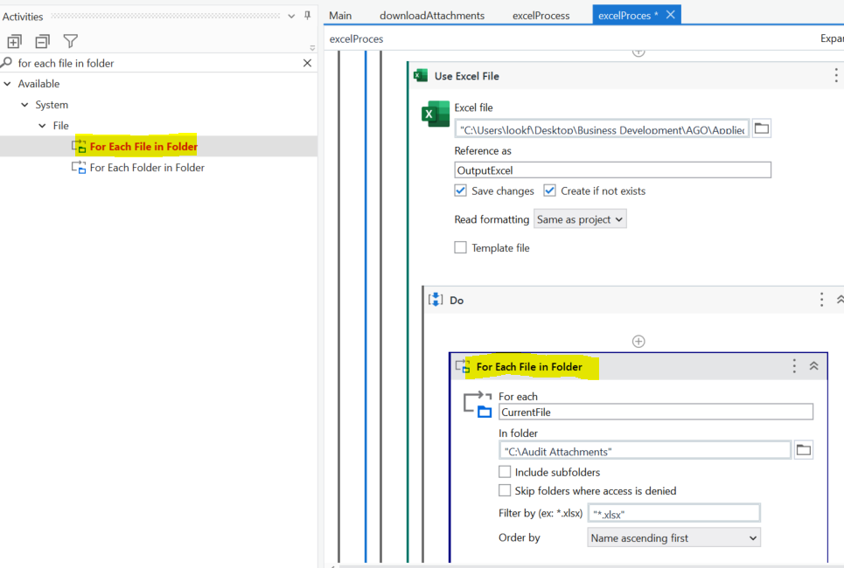
We are going to open each excel file attachment that was downloaded in C:/ Audit Attachments one by one.
Add a For Each File In Folder activity. This will help in opening all the excel file one by one.
Browse to the c:/Audit attachments folder where we keep the downloaded attachments
Add a filter:
"*.xlsx"
So only excel files are looped.

Slide 11
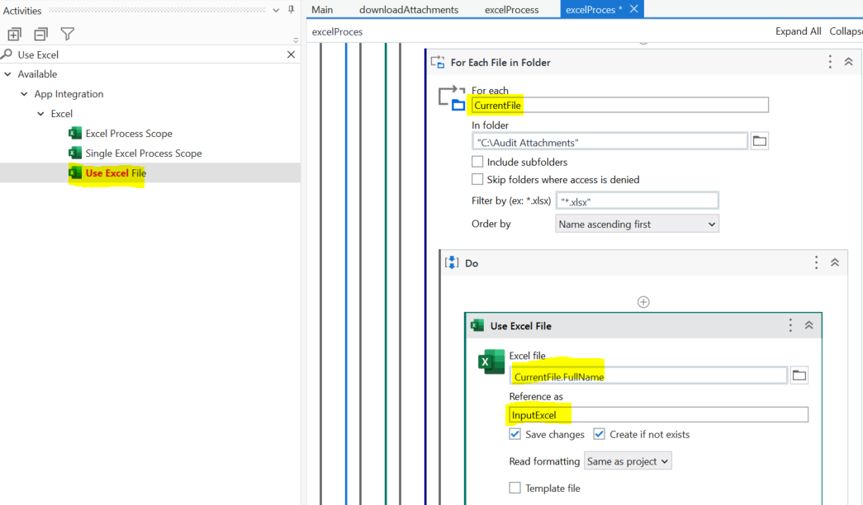
Using Use Excel File activity, we now open each input file.
Add the following for file name:
CurrentFile.FullName
This is the full file path to the current looped file.
Rename this to InputExcel for easier reference.

Slide 12
Excel Functions
Introduction to Excel Functions
Reading excel files
Appending Range

Slide 13
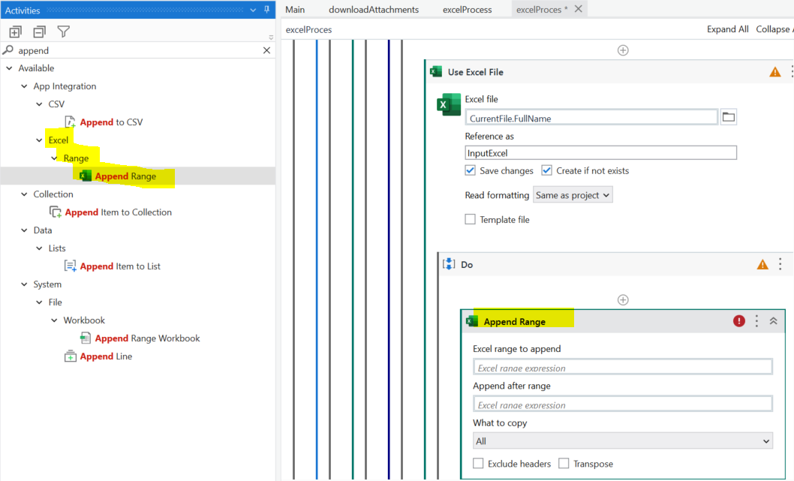
Now that we are accessing each file using a loop, append the values from InputFile into OutputFile
This is what rows to copy from input to output file
This dictates the place to add the new rows from input to output file

Slide 14
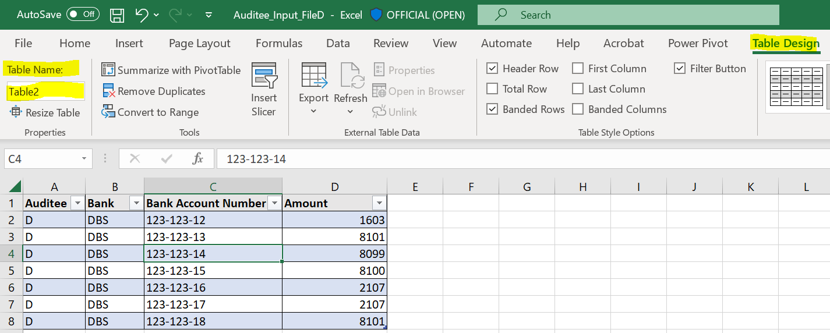
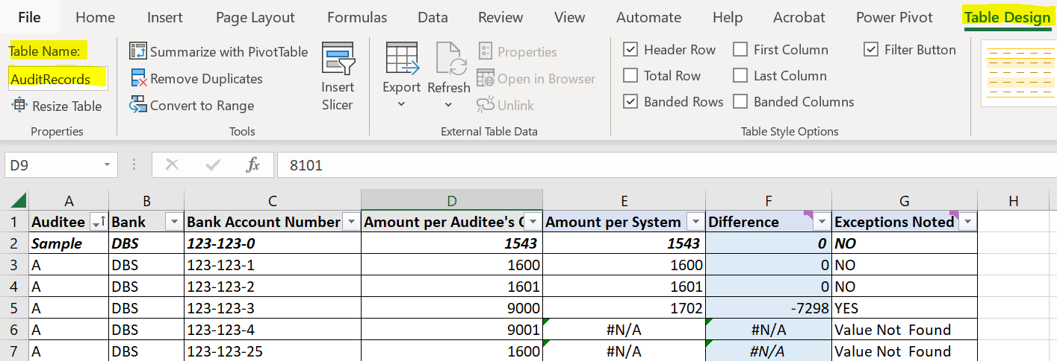
How do we know which table to copy from, and which table to append to? Using excel table name!
Open one of your InputFile excel. You will notice under
Table Design → Table Name
The table name is Table 2.
This is the range to copy from.
Open the OutputFile excel. You will notice under
Table Design → Table Name
The table name is AuditRecords.
This is the range to append to.

Slide 15
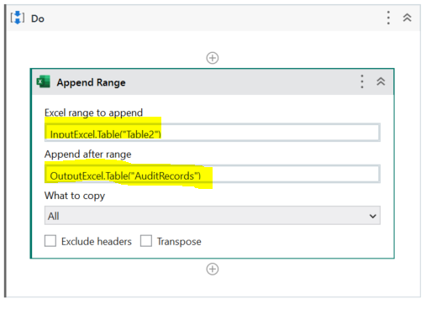
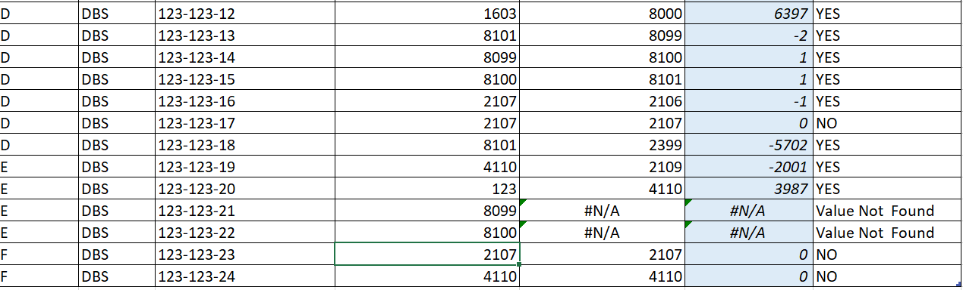
How do we know which table to copy from, and which table to append to? Using excel table name!
In the Excel range to append→
Type:
InputExcel.Table("Table2")
In the Excel range to append→
Type:
OutputExcel.Table("AuditRecords")
Run the robot to test the workflow.
Records from D,E,F input files are added to the excel file.

Slide 16
ROBOT 1
ROBOT 2
Sends Audit confirmation emails to Auditees for bank amount confirmation
Auditees replies with email with confirmation of bank account amounts
Check for emails from Auditees and download attachments
FOR EACH email and attachment, add the bank amount and other details to the Audit excel file
ROBOT 3
Robot 1 – Send Audit Email
Instead of hard coding the email address to send to, can you read an excel file, loop and send?
Can we only download attachments from unread emails so old records wont be downloaded again?
Robot 3- Append bank details to match records
Can we remove files from attachment folder after each completed run?
Robot 2 – Download auditee attachment
Can attendees add data inside email instead of an excel file?
Can the workflow just begin after the downloading of attachments instead of being another robot?
There are 3 workflows now.
What enhancements can we do?

